Slide 1

Swire Coca-Cola Predicting Customer Success
Brian Burdick
Derick Lee
Kayla Smartz
Sandy White
Notes:
Introduction of team. Description of business context, purpose of the project. Quick overview of the presentation. Avoid the "lengthy introduction" in which you provide "background." This is boring. Instead get to your main analytical insights as quickly as possible.

Slide 2
Business Problem Statement
Predict profitable customers using gross profit over a three-year period

Slide 3
Dataset Overview
Swire Datasets
Customer
Sales
Augmented by USDA Dataset:
2013 Population by zip code
Data Manipulation

Slide 4
Outcome variable
Explain this
Notes:
For our models, we created dummy variables for all categorical variables. There was a handful of observations with missing data which we also removed. One thing I noticed when reviewing the trade channel descriptions was that a lot of the information seemed redundant, which gave us concern about multicollinearity. We reduced the trade channel descriptions to a single variable for the model. Customer longevity with Swire was grouped into less than a year, 1-5 years, and more than five years. We used a 80/20 training-test split for model analysis.

Slide 5
Data Preparation and Cleaning
Created dummy variables for predictors
Removed observations with missing values (<1% of dataset)
Created test and training datasets using 80/20 split
Reduced trade and subtrade descriptions to one variable due to multicollinearity
Customer longevity grouping: < 1 year, 1-5 years, >5 years
Notes:
For our models, we created dummy variables for all categorical variables. There was a handful of observations with missing data which we also removed. One thing I noticed when reviewing the trade channel descriptions was that a lot of the information seemed redundant, which gave us concern about multicollinearity. We reduced the trade channel descriptions to a single variable for the model. Customer longevity with Swire was grouped into less than a year, 1-5 years, and more than five years. We used a 80/20 training-test split for model analysis.

Slide 6
EDA Results
Distribution and percentage of categorical variables
Average volume and discount
Best selling products
Visualized scatter plots of numeric variables
Notes:
- Limited data when onboarding new customer before Coca-Cola makes a decision

Slide 7
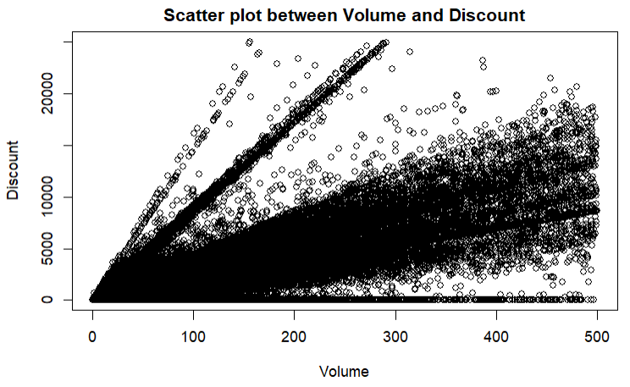
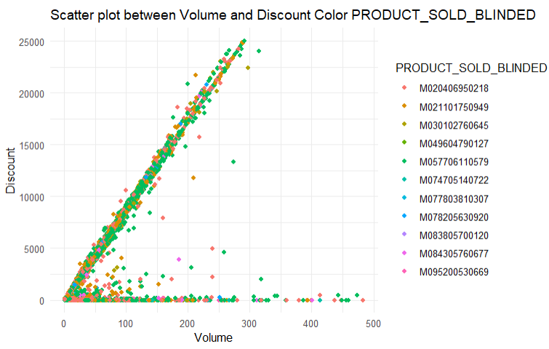
EDA Results
Core Sparkling, 5 Gallon with blinded product name of M057706110579.

Slide 8
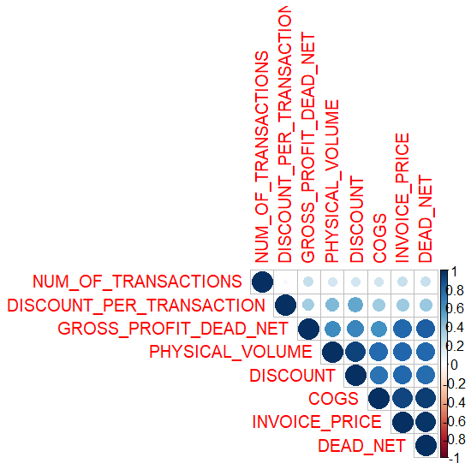
EDA – Correlation

Slide 9
Models we considered
Text text
Notes:
The first model we tried was XG Boost, which used a classification tree design. We initially used the three-year profit variable as a continuous outcome and ran XG Boost using a regression fit. This model performed very poorly, so we then used a classification method instead, grouping profit based on the 25th, 50th, and 75th percentiles. This vastly improved model performance.

Slide 10
Outcome Variables for Final Model
XG Boost
Regression performed poorly so used classification method instead
Quartile outcome variable using three-yr profit
Used 25th, 50th, and 75th percentiles for grouping
Notes:
The first model we tried was XG Boost, which used a classification tree design. We initially used the three-year profit variable as a continuous outcome and ran XG Boost using a regression fit. This model performed very poorly, so we then used a classification method instead, grouping profit based on the 25th, 50th, and 75th percentiles. This vastly improved model performance.

Slide 11
Predictor Variables for Final Model
Dummy Predictors:
Customer trade grouping
Customer longevity grouping
Population
Market description
Business type description
Notes:
To summarize, for our final models, we used the customer trade grouping, customer longevity with Swire in groups, population from the USDA, market and business type descriptions as predictors

Slide 12
XG Boost Model
Hyperparameter grid search to find best model
Five-fold cross-validation performed
Best model:
Number of trees: 667
Tree depth: 5
Learning rate: 0.1
Notes:
To summarize, for our final models, we used the customer trade grouping, customer longevity with Swire in groups, population from the USDA, market and business type descriptions as predictors

Slide 13
XG Boost Results
ROC AUC: 0.74
Accuracy: 0.48
Notes:
To summarize, for our final models, we used the customer trade grouping, customer longevity with Swire in groups, population from the USDA, market and business type descriptions as predictors

Slide 14
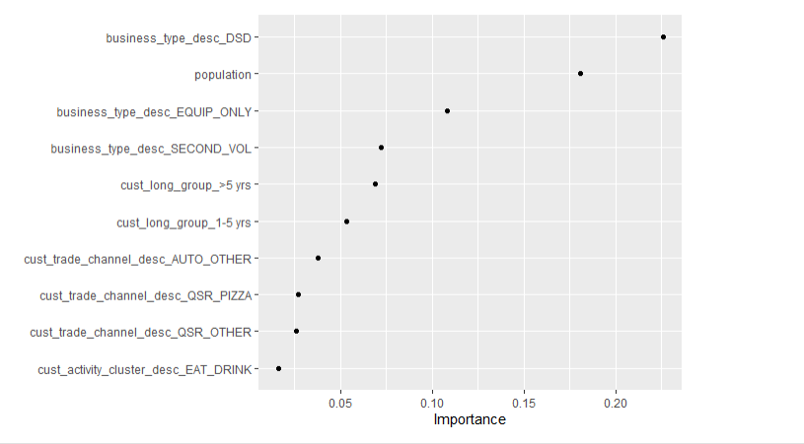
XG Boost: Most Influential Predictors
Notes:
Here is a graph which showed the most important predictors in the XG Boost Model. A business type of direct-sales distribution was the most influential, followed by population and customers that used only equipment.

Slide 15
XG Model Strengths and Limitations
Strengths:
High AUC
Multicollinearity not an issue for this type of model
Limitations:
Extremely time intensive! Over one day to run model on the complete dataset, even with using parallel processing
Difficult to interpret relationship between predictors and outcome
Accuracy was low
Notes:
To summarize, for our final models, we used the customer trade grouping, customer longevity with Swire in groups, population from the USDA, market and business type descriptions as predictors

Slide 16
Linear Regression Model
Linear Regression
Untransformed three-year profit variable did not meet assumptions of linear regression
Used log-transformed three-year profit for model instead
Adjusted R2: 0.67
Residuals normally distributed, indicating model was appropriate
Notes:
To summarize, for our final models, we used the customer trade grouping, customer longevity with Swire in groups, population from the USDA, market and business type descriptions as predictors

Slide 17
Linear Regression Model
Some highly significant positive predictors:
Local Dr. Pepper agency
Business type: DSD (direct sales distribution)
Customer longevity over 1 year
Customer trades
Automotive
Entertainment/Recreation
Quick service restaurants: Asian, Mexican, pizza, and hamburger
Travel (airline, other)
Notes:
To summarize, for our final models, we used the customer trade grouping, customer longevity with Swire in groups, population from the USDA, market and business type descriptions as predictors

Slide 18
Linear Regression Model
Some highly significant negative predictors:
Amusement–Theme parks
Industrial/Agricultural
Leisure/Social
Lodging
Chicken fast-food restaurant
Business type: Contract/Bid
Notes:
To summarize, for our final models, we used the customer trade grouping, customer longevity with Swire in groups, population from the USDA, market and business type descriptions as predictors

Slide 19
Linear Regression Strengths and Limitations
Strengths:
Model ran extremely quickly
Easy to identify relationship between predictors and outcome
Limitations:
May not have fully addressed multicollinearity
Large number of predictors may result in some being significant by chance alone
Notes:
To summarize, for our final models, we used the customer trade grouping, customer longevity with Swire in groups, population from the USDA, market and business type descriptions as predictors

Slide 20
Comparing the two models
Insert tables comparing the two models. Pros and cons. How do you compare metrics?
Notes:
To summarize, for our final models, we used the customer trade grouping, customer longevity with Swire in groups, population from the USDA, market and business type descriptions as predictors

Slide 21
Model Deployment
Text Text
- If an X customer comes in from X city in X state…
Notes:
To summarize, for our final models, we used the customer trade grouping, customer longevity with Swire in groups, population from the USDA, market and business type descriptions as predictors

Slide 22
Project Limitations
Applicability to on-boarding new customers
Longer time as Coca-Cola customer indicates better sales performance.
New customers may not provide past financials or needed data.
Start up customers do not have any past financials.

Slide 23
Dataset Recommendations
Provide customer reviews
Web scraping
Restaurant type density
Total years in business of customer
Customer churn vs business failure
Physical location description
Hours of operation, drive thru, seating capacity, franchise

Slide 24
Business Recommendations
Create a standard pricing model
Implement different pricing offers at different phases of time
RFID tags/GPS bricks on all new customers, remove after X time

Slide 25
Summary
1. Recommend use Linear Model
quick performance
easily able to identify strong predictors for higher profit
2. Standardize Pricing For Each Product
Notes:
Need to understand what data points can be determined for new customers
Linear model is recommended based of the XG Boost vs Linear Model, however there are still other models that can be explored.
In Linear Model, explore other data points. Is able to help support an outcome for a customer if able to get the data from a customer.
Need to build a standardized acceptable pricing strategy for each product

Slide 26

Questions?

